Slide 1
CH 02: Basic Structures
Sets, Functions, Sequences, Sums, and Matrices

Slide 2
Content
CH 02
Sets
Set Operations
Functions
Sequences and Summations
Cardinality of Sets
Matrices

Slide 3

Sets
DEFINITION 1: A set is an unordered collection of distinct objects, called elements or members of the set.
We write $a ∈ A$ to denote that a is an element of the set A.
The notation $a ∉ A$ denotes that a is not an element of the set A.
Roster method: the notation {a, b, c, d} represents the set with the four elements a, b, c, and d.
Example: The set of vowels {a, e, i, o, u}
Example: The set of odd positive integers less than 10: {1, 3, 5, 7, 9}

Slide 4

Sets
Intervals: Sets of all the real numbers between two numbers a and b, with or without a and b.
$[a, b] = \{x | a ≤ x ≤ b\}$
$[a, b) = \{x | a ≤ x < b\}$
$(a, b] = \{x | a < x ≤ b\}$
$(a, b) = \{x | a < x < b\}$

Slide 5

Sets
Important set names:
$N = \{0, 1, 2, 3,…\}$, the set of all natural numbers
$Z = \{…,−2,−1, 0, 1, 2,…\}$, the set of all integers
$Z^{+}= \{1, 2, 3,…\}$, the set of all positive integers
$Q = \{p∕q ∣ p ∈ Z, q ∈ Z, and q ≠ 0\}$, the set of all rational numbers
$R$, the set of all real numbers
$R^{+}$, the set of all positive real numbers
$C$, the set of all complex numbers.

Slide 6
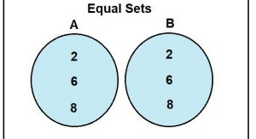

Sets
DEFINITION 2: Two sets are equal if and only if they have the same elements.
Therefore, if A and B are sets, then A and B are equal if and only if $∀x(x ∈ A ↔ x ∈ B)$.
We write A = B if A and B are equal sets.

Slide 7

Sets
The special set that has no elements is called the empty set, or null set, and is denoted by ∅.
The empty set can also be denoted by$\{ \}$
A set with one element is called a singleton set.
∅ is not the same as {∅}
{∅} is a singleton set of an empty set (example, a folder with an empty folder)
∅ is an empty set (example, an empty folder)

Slide 8
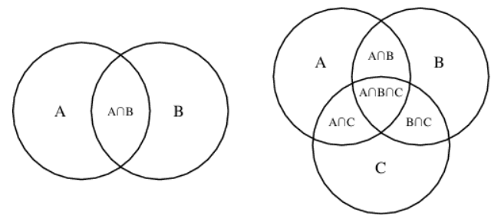
Sets
Venn Diagram

Slide 9
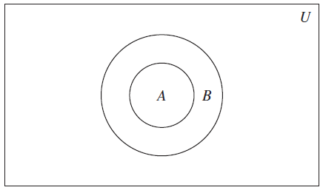
Sets
DEFINITION 3: The set A is a subset of B, and B is a superset of A, if and only if every element of A is also an element of B.
We use the notation A ⊆ B to indicate that A is a subset of the set B.
To stress that B is a superset of A, we use the equivalent notation B ⊇ A.
So, A ⊆ B and B ⊇ A are equivalent statements.

Slide 10

Sets
THEOREM 1: For every set S,
∅ ⊆ S
S ⊆ S.
To show that two sets A and B are equal, show that A ⊆ B and B ⊆ A.
Sets may have other sets as members.
For instance, $A = \{∅, \{a\}, \{b\}, \{a, b\}\}$

Slide 11

Sets
DEFINITION 4: The cardinality of a set S, $|S|$, is the number of distinct elements in S.
Example: Let A be the set of odd positive integers less than 10. Then |A| = 5.

Slide 12

Sets
DEFINITION 6: Given a set $S$, the power set of $S$ is the set of all subsets of the set $S$. The power set of S is denoted by $P(S)$.
Example: What is the power set of the set $\{0, 1, 2\}$?
Solution: $P(S) = \{∅, \{0\}, \{1\}, \{2\}, \{0, 1\}, \{0, 2\}, \{1, 2\}, \{0, 1, 2\}\}$.

Slide 13

Sets
DEFINITION 7: The ordered n-tuple $(a_{1}, a_{2},…, a_{n})$ is the ordered collection that has $a_{1}$ as its first element, $a_{2}$ as its second element,…, and $a_{n}$ as its nth element.

Slide 14

Sets
DEFINITION 8: Let $A$ and $B$ be sets. The cartesian product of $A$ and $B$, denoted by $A × B$, is the set of all ordered pairs $(a, b)$, where $a ∈ A$ and $b ∈ B$. Hence, $A × B = \{(a, b) ∣ a ∈ A ∧ b ∈ B\}$.
Example: What is the Cartesian product of $A = \{1, 2\}$ and $B = \{a, b, c\}$?
Solution: $A × B = \{(1, a), (1, b), (1, c), (2, a), (2, b), (2, c)\}$.

Slide 15

Sets
DEFINITION 9: The Cartesian product of the sets $A_{1}, A_{2},…, A_{n}$ is the set of ordered n-tuples $(a_{1}, a_{2},…, a_{n})$, where $a_{i}$ belongs to $A_{i}$ for $i = 1, 2,…, n$.
In other words, $A_{1} × A_{2} ×⋯× A_{n} = \{(a_{1}, a_{2},…, a_{n}) ∣ a_{i} ∈ A_{i} for i = 1, 2,…, n\}$.
Example: What is the Cartesian product A × B × C, where $A = \{0, 1\}, B = \{1, 2\}$, and $C = \{0, 1, 2\}$?
Solution: $A × B × C = \{(0, 1, 0), (0, 1, 1), (0, 1, 2), (0, 2, 0), (0, 2, 1), (0, 2, 2), (1, 1, 0), (1, 1, 1), (1, 1, 2), (1, 2, 0), (1, 2, 1), (1, 2, 2)\}$.

Slide 16

Exercises
9. For each of the following sets, determine whether 2 is an element of that set.
a) $\{x ∈ R| x is an integer greater than 1\}$
c) $\{2,\{2\}\}$
d) $\{\{2\},\{\{2\}\}\}$

Slide 17
Exercises
9. For each of the following sets, determine whether 2 is an element of that set.
a) $\{x ∈ R| x is an integer greater than 1\}$
c) $\{2,\{2\}\}$
d) $\{\{2\},\{\{2\}\}\}$
Yes
Yes
No

Slide 18
Exercises
13. Determine whether each of these statements is true or false.
a) x ∈ {x} e) ∅ ⊆ {x} c) {x} ∈ {x}

Slide 19
Exercises
13. Determine whether each of these statements is true or false.
a) x ∈ {x} e) ∅ ⊆ {x} c) {x} ∈ {x}
True
True
False

Slide 20

Exercises
21 - 22. What is the cardinality of each of these sets?
a) $\{a\}$ b) {∅} c) $\{∅, \{∅\}\}$ d) $\{a, \{a\}, \{a, \{a\}\}\}$

Slide 21
Exercises
21 - 22. What is the cardinality of each of these sets?
a) $\{a\}$ b) {∅} c) $\{∅, \{∅\}\}$ d) $\{a, \{a\}, \{a, \{a\}\}\}$
1
1
2
3

Slide 22

Exercises
23. Find the power set of each of these sets, where $a$ and $b$ are distinct elements.
a) $\{a\}$ b) $\{a, b\}$ c) $\{∅, \{∅\}\}$

Slide 23



Exercises
23. Find the power set of each of these sets, where $a$ and $b$ are distinct elements.
a) $\{a\}$ b) $\{a, b\}$ c) $\{∅, \{∅\}\}$
$$\{∅, \{a\}\}$$
$$\{∅, \{a\}, \{b\}, \{a, b\}\}$$
$$\{∅, \{∅\}, \{\{∅\}\}, \{∅, \{∅\}\}\}$$

Slide 24

Exercises
29. Let A = $\{a, b, c, d\}$and $B = \{y, z\}$. Find
b) B × A.

Slide 25

Exercises
29. Let A = $\{a, b, c, d\}$and $B = \{y, z\}$. Find
b) B × A.
$$\{$$
$$(y, a), (y, b), (y, c), (y, d), \\ \left(z, a\right),\left(z, b\right), \left(z, c\right), \left(z, d\right)$$
$$\}$$

Slide 26
Exercises
34. Let A = {a, b, c}, B = {x, y}, and C = {0, 1}. Find
a) A × B × C. b) C × B × A. c) C × A × B. d) B × B × B.

Slide 27

Exercises
34. Let A = {a, b, c}, B = {x, y}, and C = {0, 1}. Find
a) A × B × C. b) C × B × A. c) C × A × B. d) B × B × B.
$\{(a, x, 0), (a, x, 1), (a, y, 0), (a, y, 1), (b, x, 0), (b, x, 1), (b, y, 0), (b, y, 1), (c, x, 0), (c, x, 1), (c, y, 0), (c, y, 1)\}$
b) $\{(0, x, a), (0, x, b), (0, x, c), (0, y, a), (0, y, b), (0, y, c), (1, x, a), (1, x, b), (1, x, c), (1, y, a), (1, y, b), (1, y, c)\}$
c) $\{(0, a, x), (0, a, y), (0, b, x), (0, b, y), \left(0, c, x\right), (0, c, y), (1, a, x), (1, a, y), (1, b, x), (1, b, y), (1, c, x), (1, c, y)\}$
d) $\{(x, x, x), (x, x, y), (x, y, x), (x, y, y), (y, x, x), (y, x, y), (y, y, x), (y, y, y)\}$

Slide 28

Exercises
35. Find $A^{2}$ if
a) A = {0, 1, 3}.

Slide 29

Exercises
35. Find $A^{2}$ if
a) A = {0, 1, 3}.
$$\{$$
$$\left(1, 0\right), \left(1, 1\right), \left(1, 3\right), (0, 0), (0, 1), (0, 3),$$
$$\left(3, 0\right), \left(3, 1\right), \left(3, 3\right)$$
$$\}$$

Slide 30
TASKS
Section 1
9 (e, b, f)
13 (a, e, c)
21 (a, d)
22 (b, c)
29 (a)
35 (b)

Slide 31
Content
CH 02
Sets
Set Operations
Functions
Sequences and Summations
Cardinality of Sets
Matrices

Slide 32
Set Operations
Operations
Union
Intersection
Difference
Complement

Slide 33
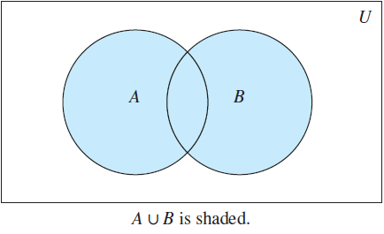
Set Operations
Union: Let A and B be sets. The union of the sets A and B, denoted by A ∪ B, is the set that contains those elements that are either in A or in B, or in both.
A ∪ B = {x ∣ x ∈ A ∨ x ∈ B}.

Slide 34
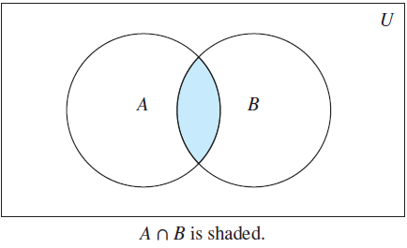
Set Operations
Intersection: Let A and B be sets. The intersection of the sets A and B, denoted by A ∩ B, is the set containing those elements in both A and B.
A ∩ B = {x ∣ x ∈ A ∧ x ∈ B}.

Slide 35
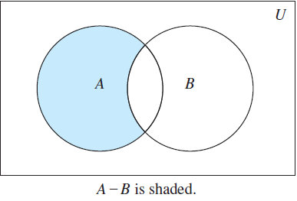
Set Operations
Difference: Let A and B be sets. The difference of A and B, denoted by A − B, is the set containing those elements that are in A but not in B.
The difference of A and B is also called the complement of B with respect to A..
A − B = {x ∣ x ∈ A ∧ x ∉ B}.

Slide 36
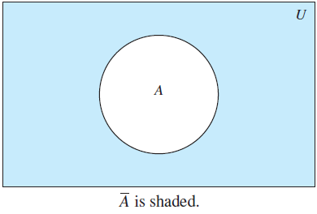

Set Operations
Complement: Let U be the universal set. The complement of the set A, denoted by $\overline{A}$, is the complement of A with respect to U.
Therefore, the complement of the set A is U − A.
$\overline{A} = \{x ∈ U ∣ x ∉ A\}$.

Slide 37

Set Operations
DEFINITION 3: Two sets are called disjoint if their intersection is the empty set.
Example: Let A = {1, 3, 5, 7, 9} and B = {2, 4, 6, 8, 10}. Because A ∩ B = ∅, A and B are disjoint.
To find the cardinality of a union of two finite sets A and B. $|A ∪ B| = |A| + |B| − |A ∩ B|.$

Slide 38
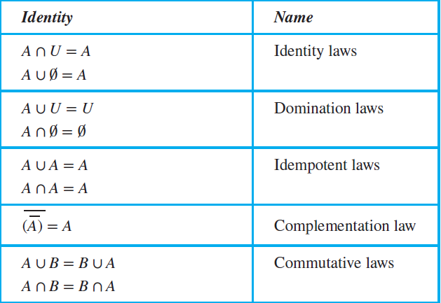
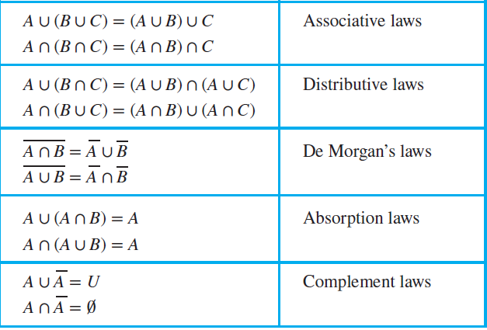
Set Operations
Set Identities:

Slide 39
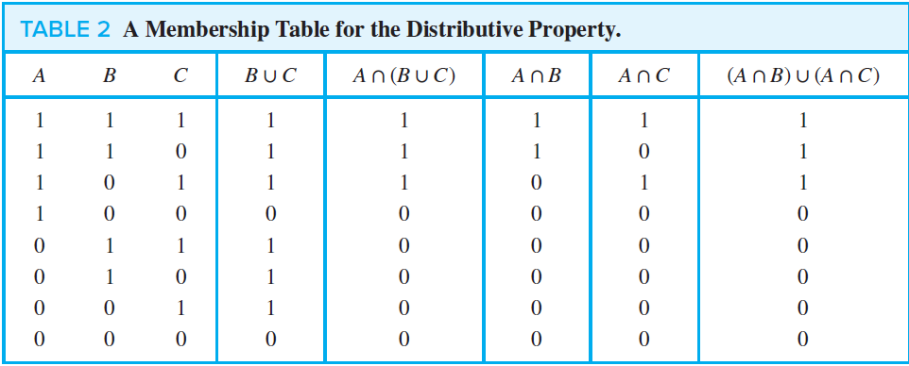
Set Operations
Use a membership table to show that A ∩ (B ∪ C) = (A ∩ B) ∪ (A ∩ C).

Slide 40

Set Operations
Generalized Union:
$$A_{1} ∪ A_{2} ∪⋯∪ A_{n} =U_{i=1}^{n}A_{i}$$
Generalized Intersection:
$$A_{1} ∩ A_{2}∩⋯∩A_{n} =∩_{i=1}^{n}A_{i}$$

Slide 41
Exercises
3. Let A = {1, 2, 3, 4, 5} and B = {0, 3, 6}. Find
a) A ∪ B. b) A ∩ B. c) A − B. d) B − A.

Slide 42
Exercises
3. Let A = {1, 2, 3, 4, 5} and B = {0, 3, 6}. Find
a) A ∪ B. b) A ∩ B. c) A − B. d) B − A.
a) {0,1,2,3,4,5,6}
b) {3}
c) {1, 2, 4,5}
d) {0, 6}

Slide 43

Exercises
19. Show that if A, B, and C are sets, then $\overline{A ∩ B ∩ C}= \overline{A} ∪ \overline{B} ∪\overline{C }$
a) by showing each side is a subset of the other side.
b) using a membership table.

Slide 44

Exercises
19. Show that if A, B, and C are sets, then $\overline{A ∩ B ∩ C}= \overline{A} ∪ \overline{B} ∪\overline{C }$
a) by showing each side is a subset of the other side.
b) using a membership table.
a)
$$x ∈ \overline{A ∩ B ∩ C} ≡ \\ x ∉ A ∩ B ∩ C ≡ \\ x ∉ A ∨ x ∉B ∨ x∉C ≡ \\ x∈\overline{A} ∨ x∈\overline{B} ∨ x ∈ \overline{C} ≡ \\ x∈\overline{A}∪\overline{B}∪\overline{C}$$

Slide 45
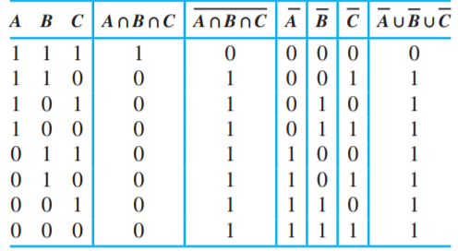
Exercises
19. Show that if A, B, and C are sets, then $\overline{A ∩ B ∩ C}= \overline{A} ∪ \overline{B} ∪\overline{C }$
a) by showing each side is a subset of the other side.
b) using a membership table.

Slide 46

Exercises
53. Let $A_{i} = \{1, 2, 3,…, i\}$ $for i = 1, 2, 3, …$. Find
a)$\bigcup_{i=1}^{n}{A_{i}}$

Slide 47
Exercises
53. Let $A_{i} = \{1, 2, 3,…, i\}$ $for i = 1, 2, 3, …$. Find
a)$\bigcup_{i=1}^{n}{A_{i}}$
a) $\{1, 2, 3, … , n\}$

Slide 48

Exercises
54. Let $A_{i} = \{…,−2,−1, 0, 1,…, i\}$. Find
b) $\bigcap_{i=1}^{n}{A_{i}}$

Slide 49

Exercises
54. Let $A_{i} = \{…,−2,−1, 0, 1,…, i\}$. Find
b) $\bigcap_{i=1}^{n}{A_{i}}$
We note that these sets are increasing, that is, $A1 ⊑A2 ⊑A3$. The intersection is just the one with the smallest subscript.
$$A_{1}=\{…, −2, −1, 0, 1\}$$

Slide 50
TASKS
Section 2
4
53 (b)
54 (a)

